Slide 1

Grocery Shared Shopping List
FoodLoot
Ramy Gildenberg
Shay Kremer

Slide 2
Goals
Manage grocery shopping list.
Joint list , shared access with selected users, shared-experience shopping.
Shopping list is separated to sections , dairy , meat , canned goods , pasta , drinks , etc. to efficiently walk through the supermarket and never scrolling along their list , looking for goods that belong to that aisle.
Saving products on local/cloud database , using autofill when making a list , plus having the benefit of going through a saved products list and cross-checking in real time for lacking products instead of opening all the cabinets in the kitchen for example

Slide 3
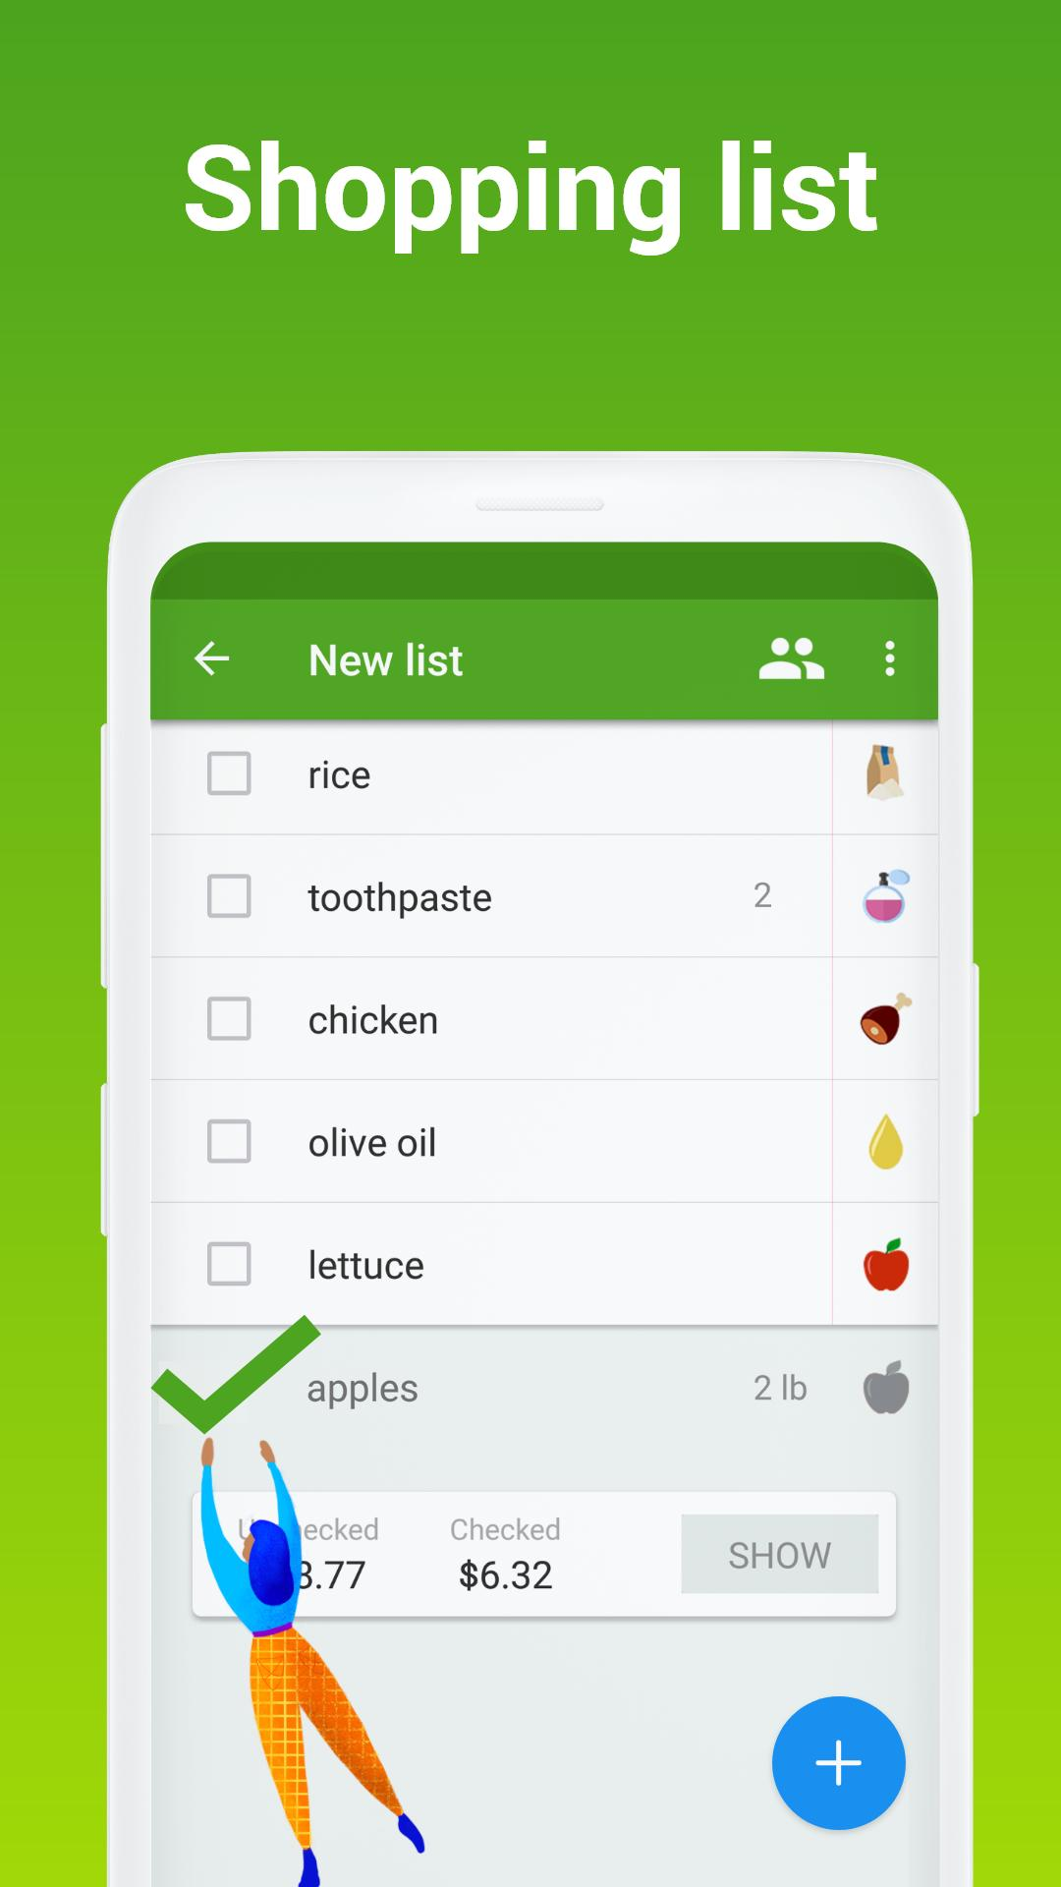

Market Competition
Listonic
List items
Price summed up
No sections
Shared super-market experience

Slide 4
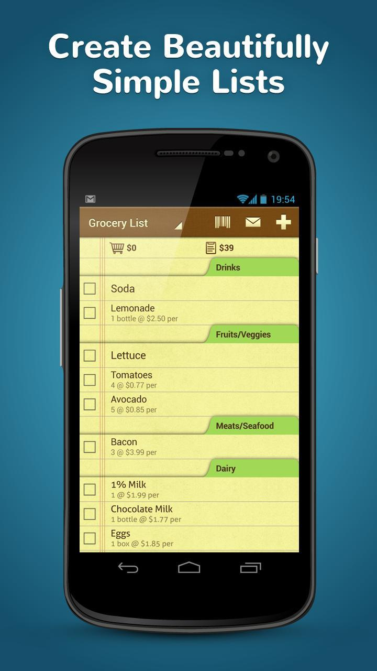
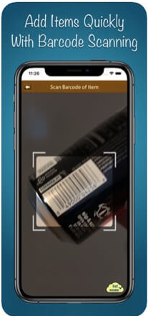
List Ease
Basically does what we want but we want a Hebrew version.
Barcode scanning of produce
Crossed off products go to the end of the list , where they can be unchecked for the next list

Slide 5
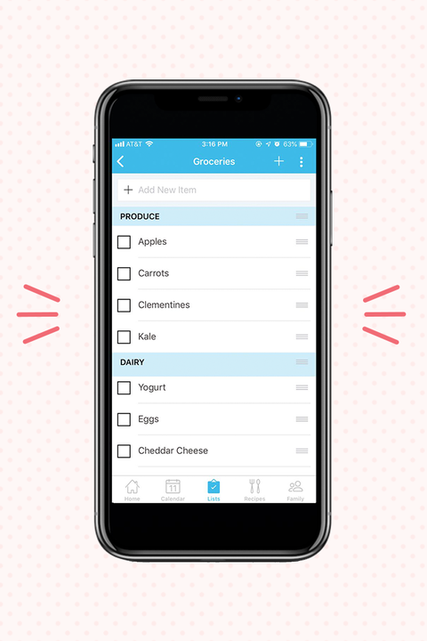
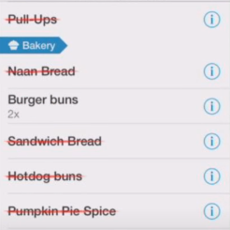
AnyList
The best app on the market , integration with calendar .
Synced list , crossed off products are updated on the fly.
Not exclusive to shopping.

Slide 6
What we going to do differently?
Use speech to text
While other apps do what we want to do as well , we will try and implement a better filtering ui

Slide 7
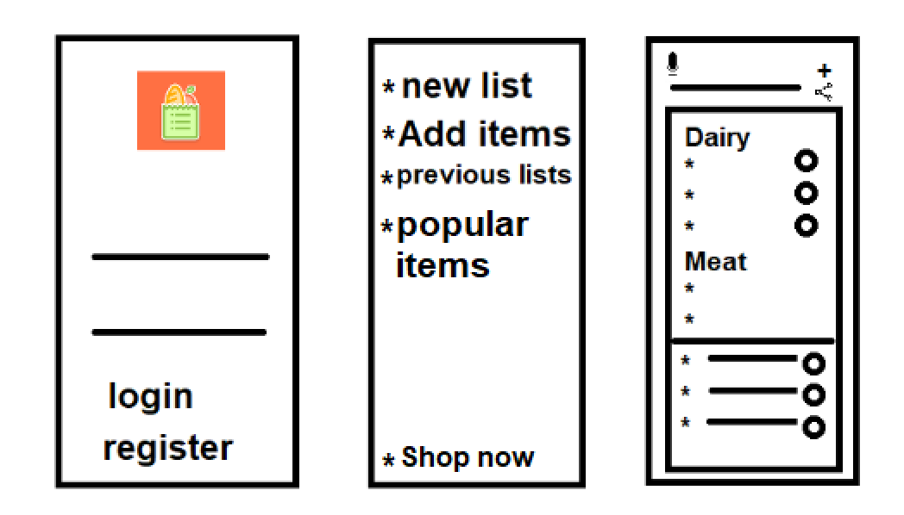
Description
Registration & Login Screen
Make new list , add items to database , watch previous lists, see popular items
Search with speech-to-text, add items ,invite people to edit/watch list
Shop together as list updates on the go(maybe)

Slide 8
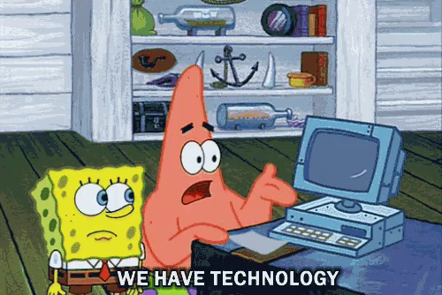
Technologies
Speech-To-Text
Firebase

